Slide 1
W04 – Setting up minimal spark environment without Docker installed
2024
The Hoang

Slide 2
Notes
The following slides guide you how to install the environment to practice Spark coding in this course.
For each software or dependency, there are multiple ways to install. Feel free to pick up one which is most familiar to you. You’re not required to fully comply with all the steps.
The ultimate acceptance: criteria is you can execute notebooks containing Pyspark codes with no errors.

Slide 3
Environment setup – Python & PIP
Install Python
Preferred version: 3.11.9. Note that the higher versions (3.12.x) can cause error during executing Spark applications
Verification
python --version
Upgrade pip
python -m pip install --upgrade pip
Verification
pip -–version

Slide 4
Environment setup - Pyspark
Install latest Pyspark version:
pip install pyspark
Verification:
pip list => the pyspark version 3.5.x should be displayed

Slide 5
Environment setup - Java
Download & Install latest Java 8 from Oracle (8u421)
Verification:
java -version

Slide 6
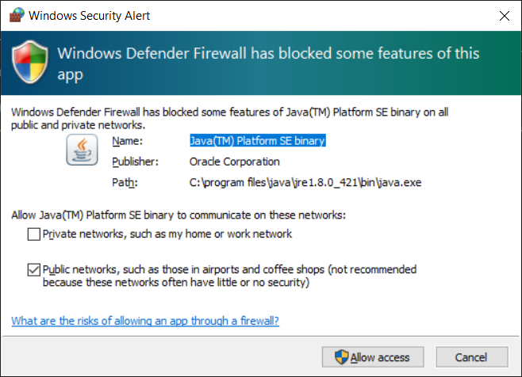
Environment setup - Java
Download & Install latest Java 8 from Oracle (8u421)
Allow network access if the below popup shows up

Slide 7

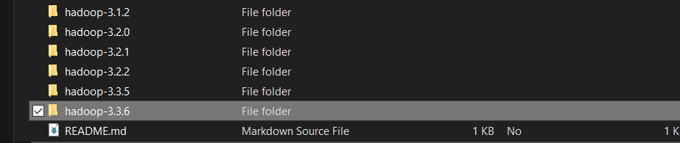
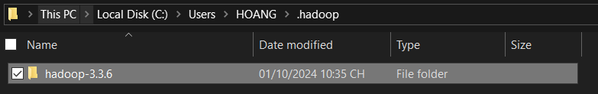
Environment setup – Hadoop binary
Download winutils-master.zip from this Github link:
Unzip the downloaded file, copy the Hadoop-3.3.6 folder:
Paste the copied folder to a new folder. Example: C:\Users\HOANG\.hadoop\
Change to your PC username

Slide 8

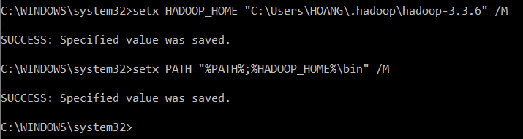
Environment setup – System variables
Pyspark Python:
Run this command in windows cmd as administrator:
setx PYSPARK_PYTHON “python” /M
Verification:
echo %PYSPARK_PYTHON%
Hadoop home
setx HADOOP_HOME "C:\Users\HOANG\.hadoop\hadoop-3.3.6" /M
setx PATH "%PATH%;%HADOOP_HOME%\bin" /M
Change to your PC username

Slide 9
Try executing a simple Pyspark Application
Launch Python shell
Execute following codes
from pyspark.sql import SparkSession as ss
# init Spark session
spark = ss.builder.appName('test').master('local').getOrCreate()
# creating a new Spark dataframe from a simple list
df = spark.createDataFrame([(1,)], 'id int')
# display the dataframe
df.show()
# write the dataframe to the filesystem
df.write.csv('verify_write.csv')
# read the written file as a new dataframe and display it
df_test = spark.read.csv('verify_write.csv')
df_test.show()

Slide 10
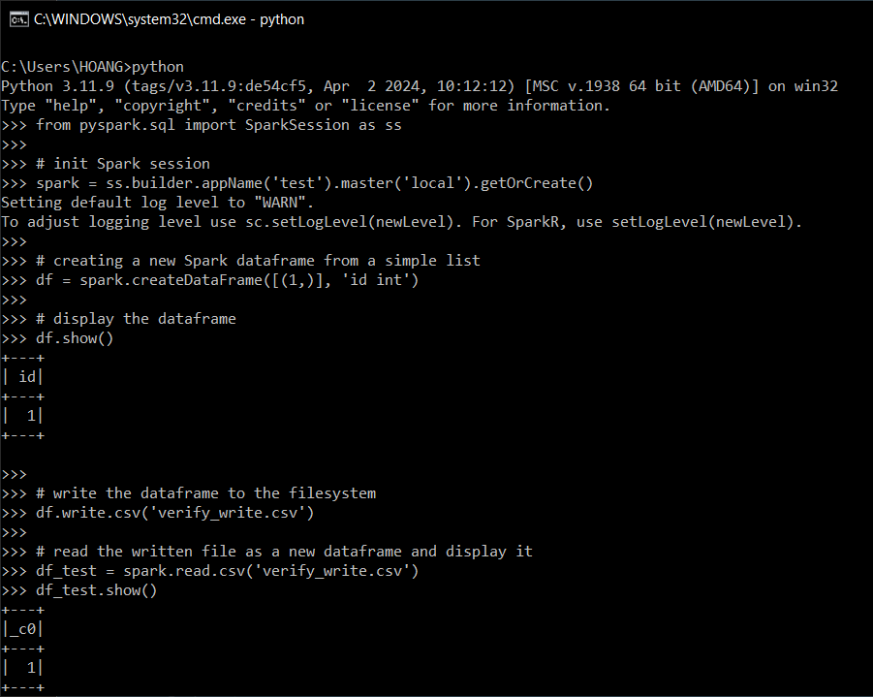
Try executing a simple Pyspark Application
Expected results

Slide 11
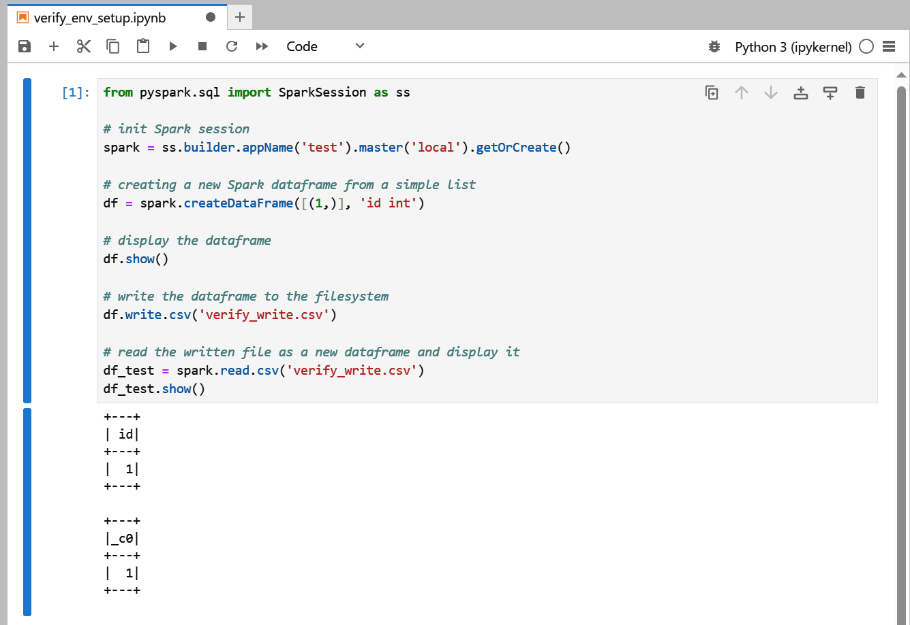
Install Jupyterlab
Execute following command to install and launch Jupyterlab
pip install jupyterlab
jupyter lab
Execute the codes copied from previous slide to verify the Pyspark work well from JupyterLab

Slide 12
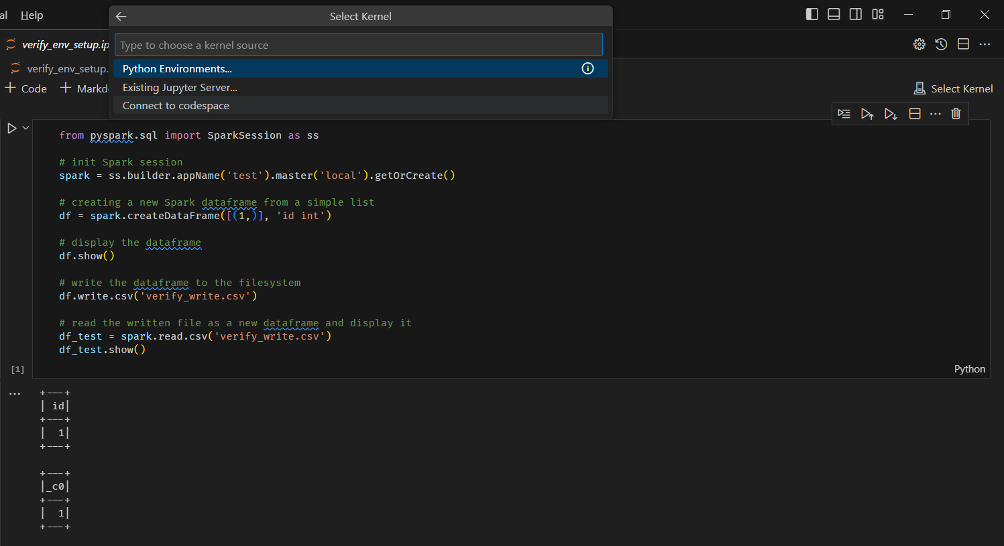
Integrate with Visual Code
Select Kernel
Existing Jupyter Server
Enter password
Save as “localhost”

Slide 13
Optional
You can setup pyenv to easily switch between Python versions. Link
If you want to isolate this environment, create a virtual environment for it (venv). Link

